Slide 1

LIBRARY MANAGEMENT

Slide 2

INTRODUCTION
Full Stack Application – Library Management.
A library management system is an application that is designed to manage all the functions of a library. It helps librarians to maintain the database of new books and the books that are borrowed by members. This system completely automates all your library's activities.
The basic functions of library management include overseeing all library operations and managing data.

Slide 3
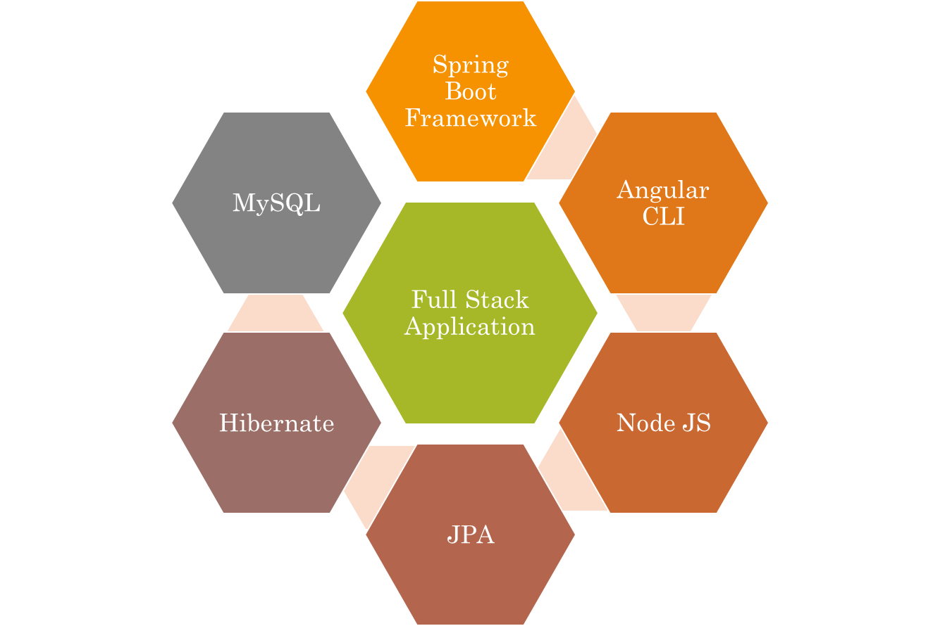
Technologies used.

Slide 4
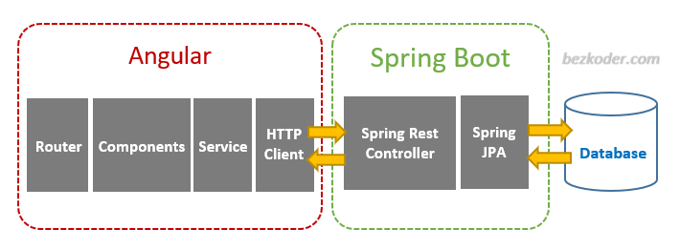


The Architecture of Angular, Spring
& database(MySQL)

Slide 5
The Architecture of the Project
Angular JS
Node JS
Frontend
Spring Boot
Backend
MySQL

Slide 6
Services
Check Book Status
Update Book
Check Book Price
Services
Add Book

Slide 7
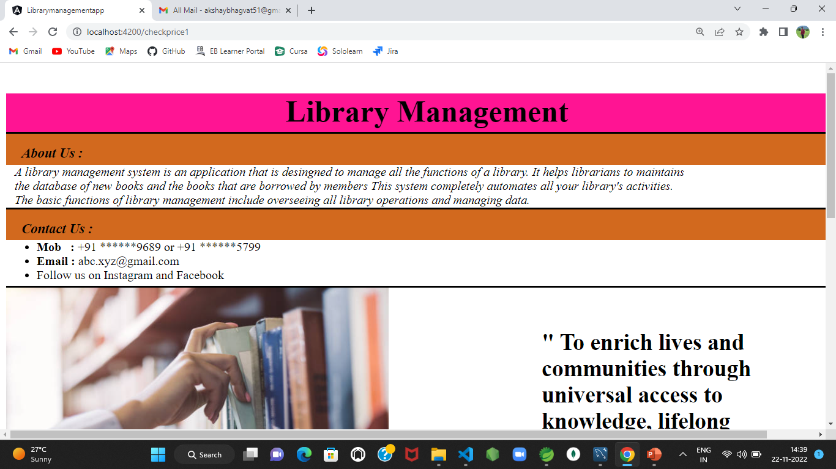
User Interface(UI)

Slide 8
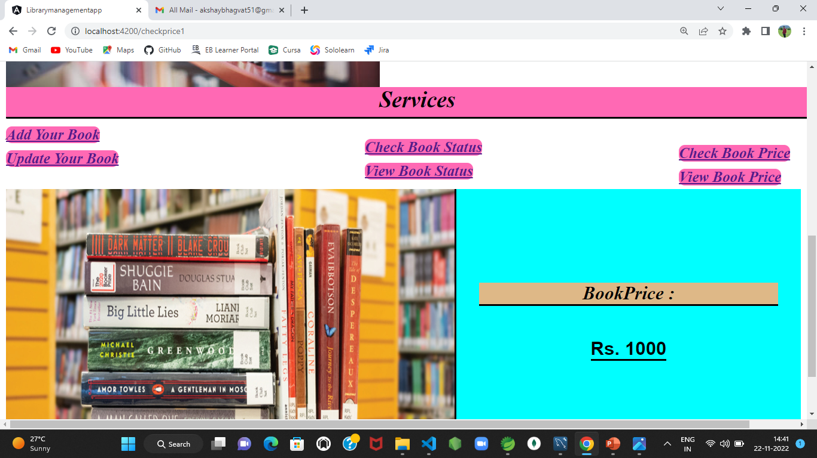
Services

Slide 9
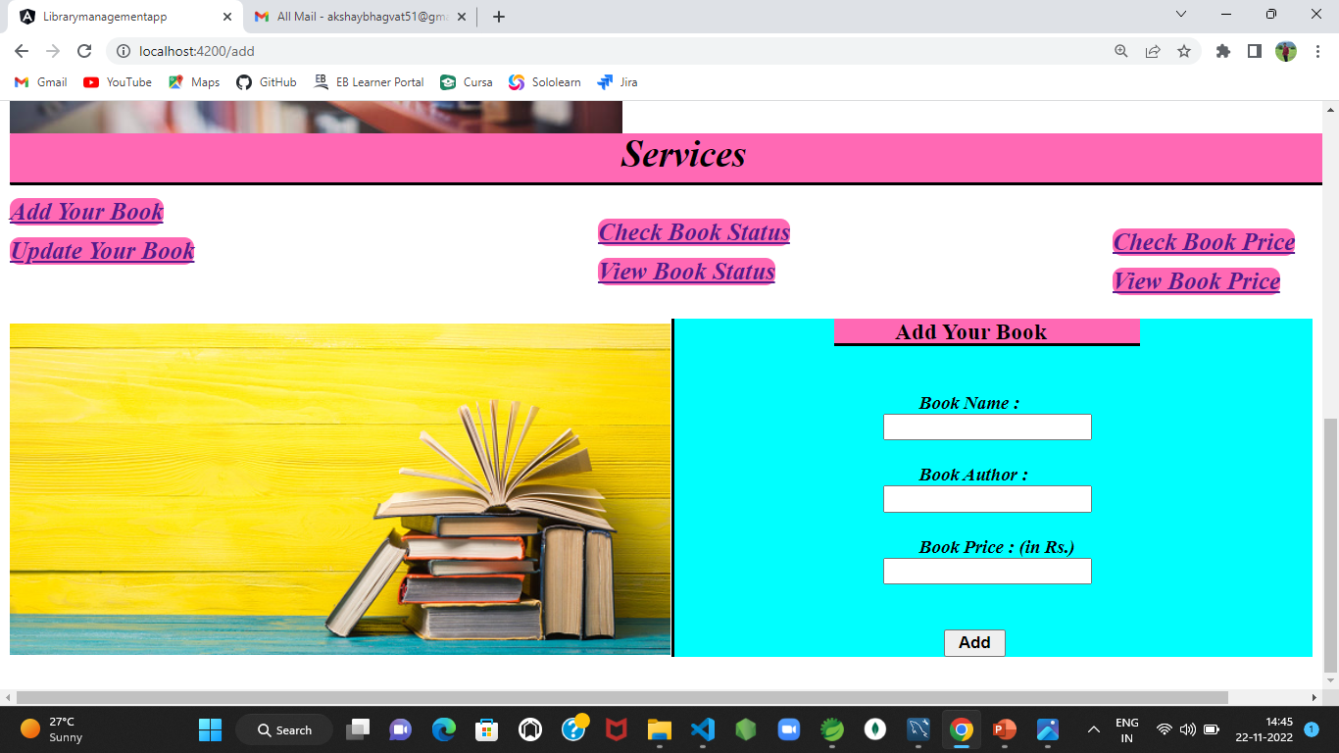
ADD

Slide 10
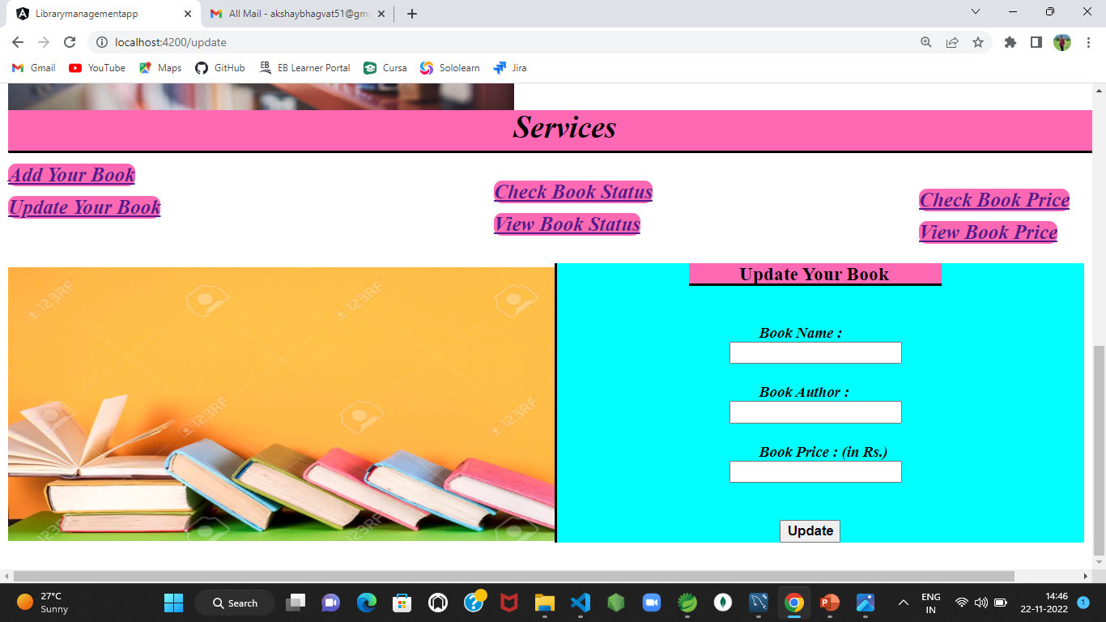
Update

Slide 11
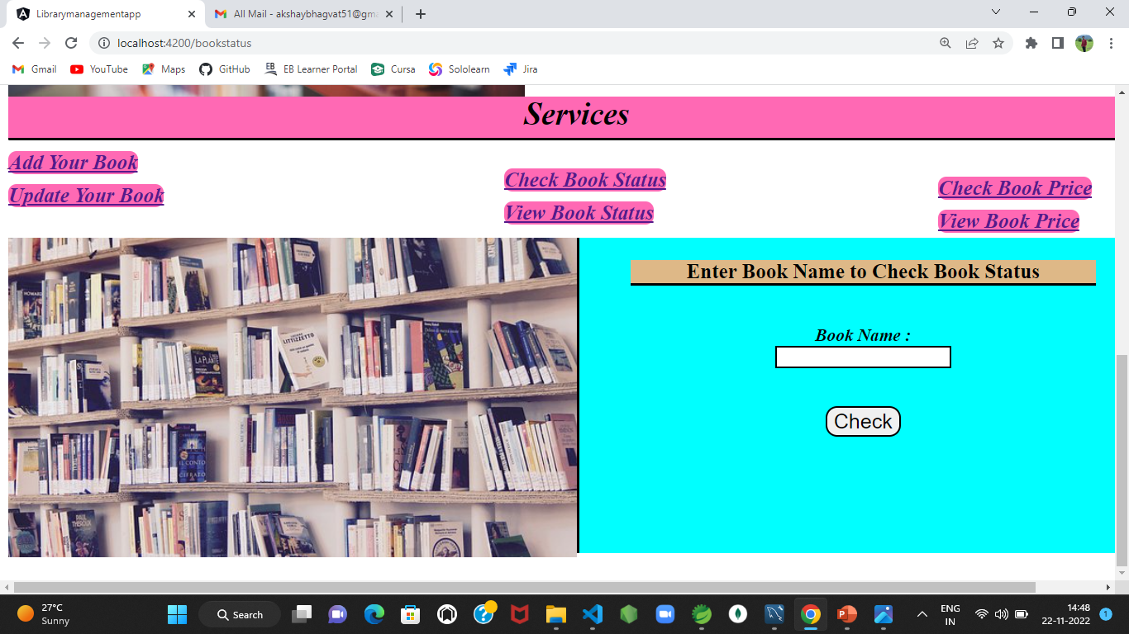
Check Book Status

Slide 12
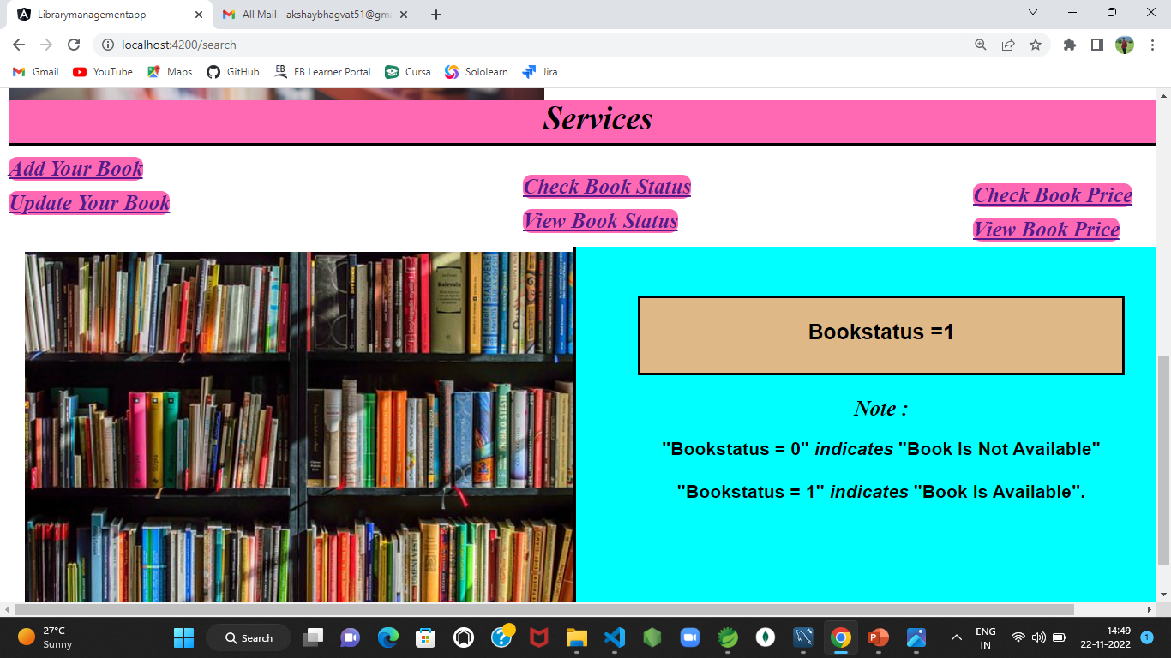
View Book Status

Slide 13
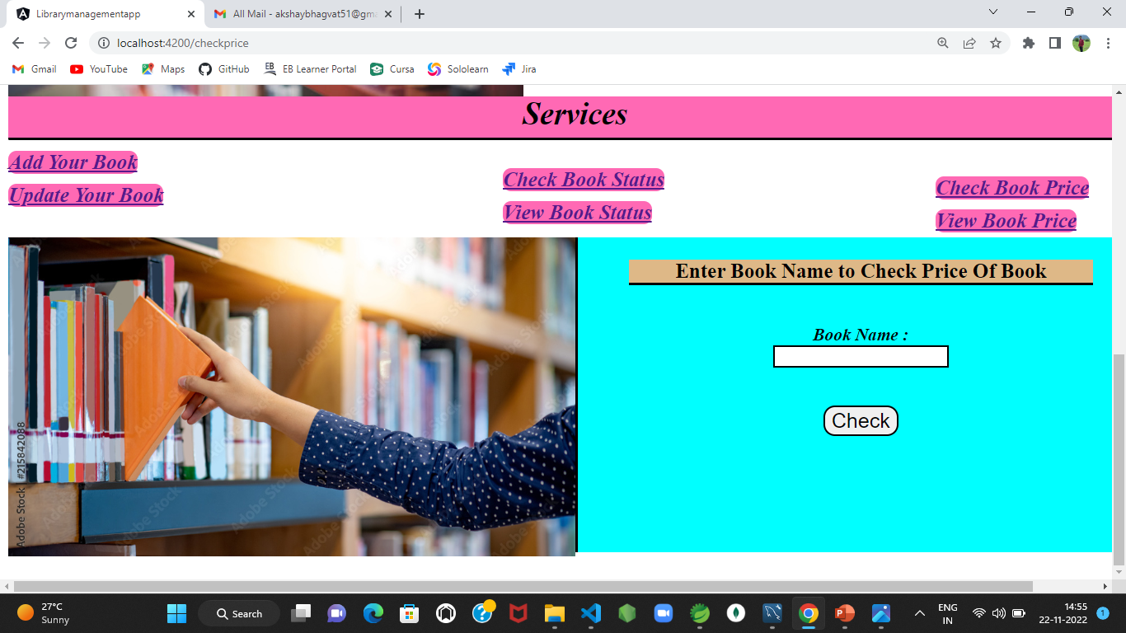
Check Book Price

Slide 14
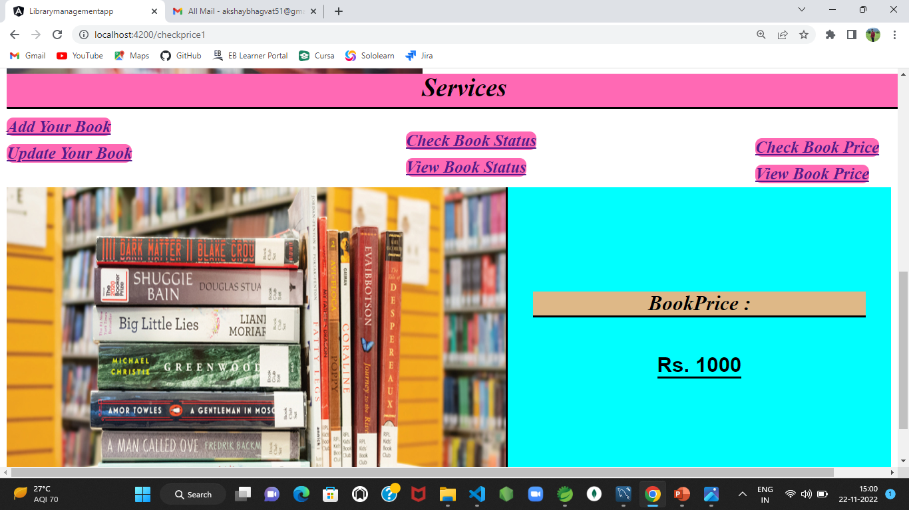
View Book Price

Slide 15
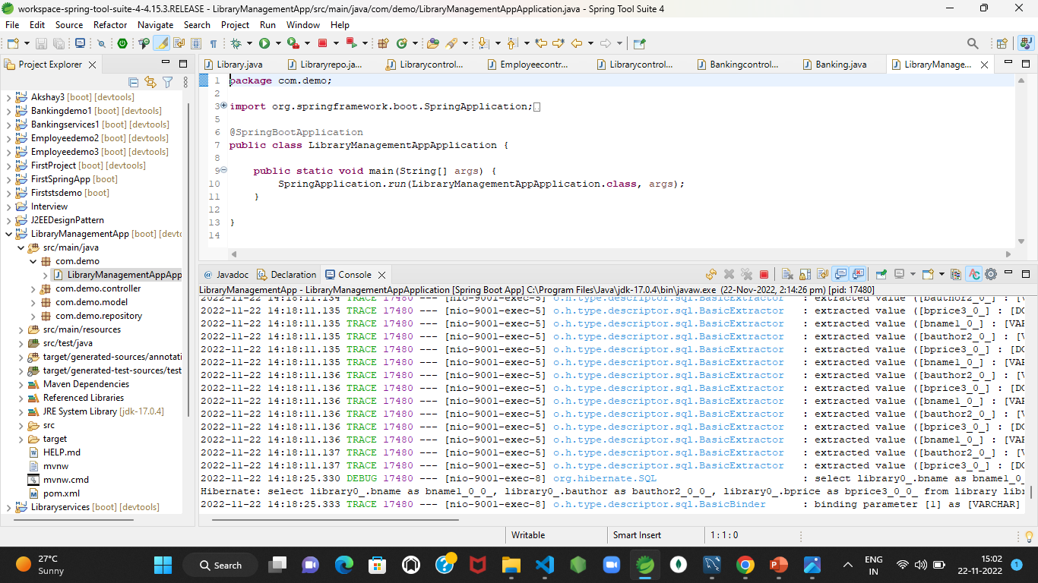
Spring Boot Application

Slide 16
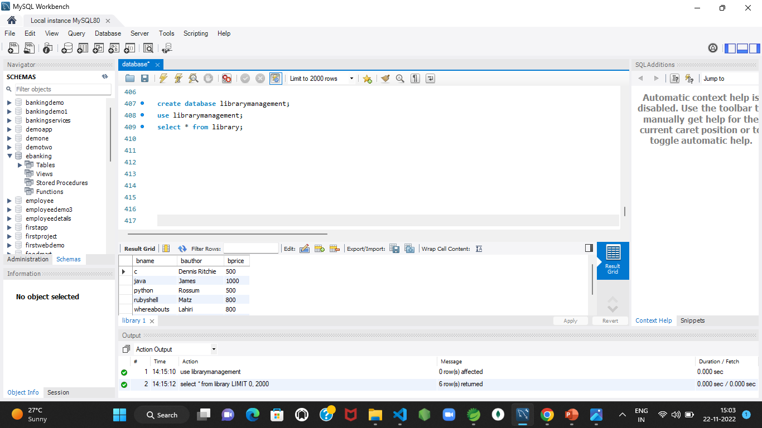
MySQL Code

Slide 17
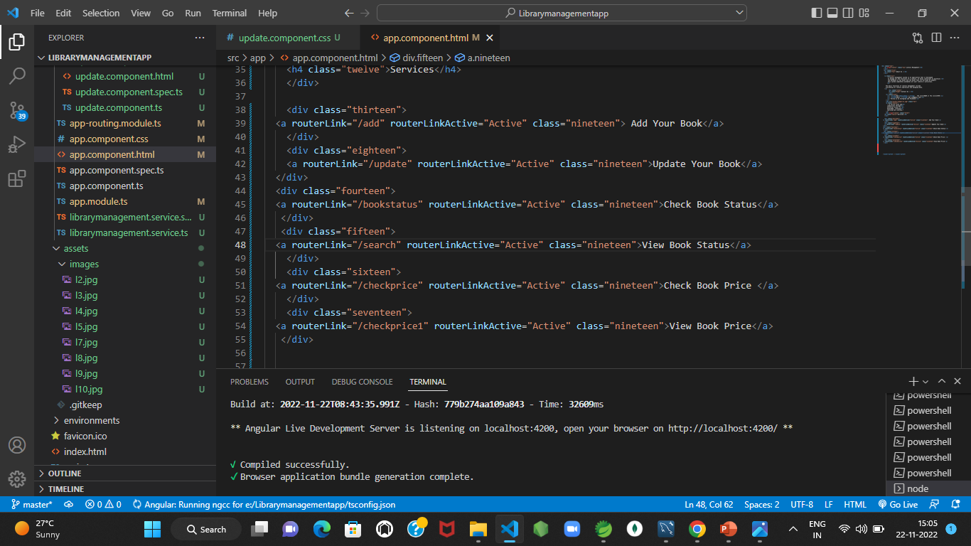
Frontend – Angular JS

Slide 18

The scope of this project is as follows:
We can easily go through all the data of library and Access it.
There are various services added in this project like add, update, check book status and check book price.
By using these services it will become more comfortable to handle library data for staff members and users also.
The system generates types of information that can be used for various purposes.

Slide 19

GitHub Link

Slide 20

Thank you.

